Slide 1

MENTORNESS INTERSHIP PROGRAM

Slide 2

The CORONA VIRUS pandemic has had a significant impact on public health and has created an
urgent
need for data-driven insights to understand the spread of the virus. As a data analyst, I have been
tasked with analyzing a CORONA VIRUS dataset to derive meaningful insights and present your
findings.
PROJECT OVERVIEW

Slide 3

Dataset:
Description of each column in dataset
PROVINCE :- Geographic subdivision
within A country/region.
COUNTRY/REGION: Geographic
entity where data is recorded.
DATE: RECORDED DATE OF CORONA
VIRUS DATA.
CONFIRMED: NUMBER OF
DIAGNOSED CORONA VIRUS CASES.
DEATHS: NUMBER OF CORONA VIRUS
RELATED DEATHS.
RECOVERED: NUMBER OF
RECOVERED CORONA VIRUS CASES.

Slide 4
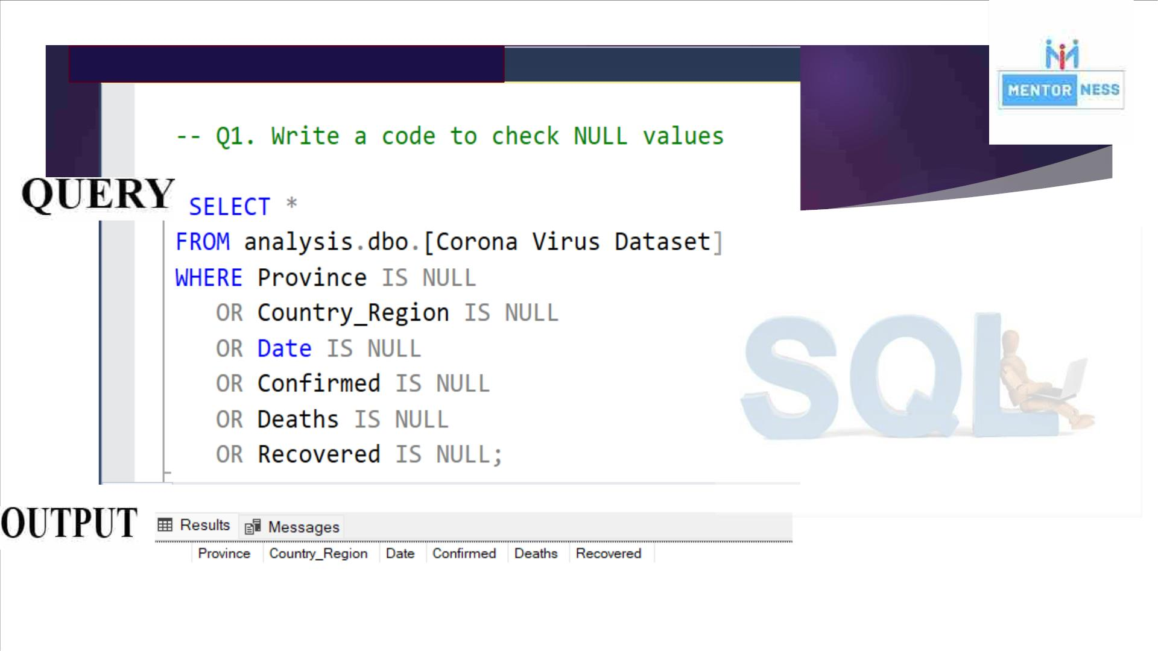

Slide 5
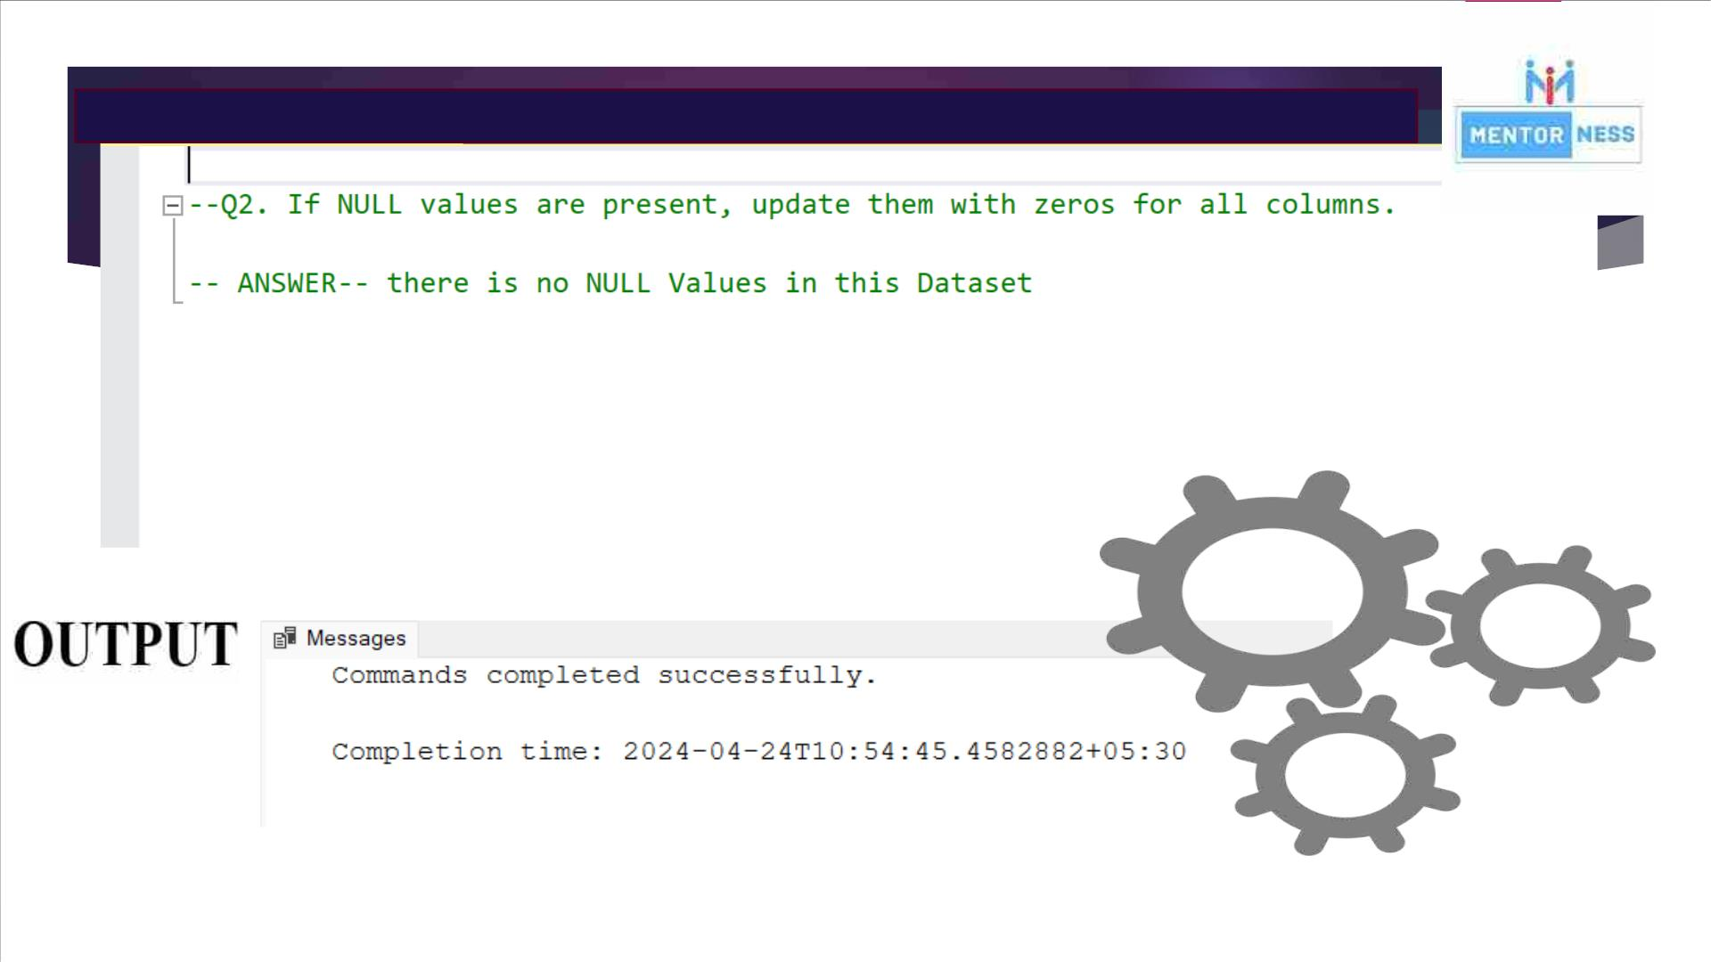

Slide 6
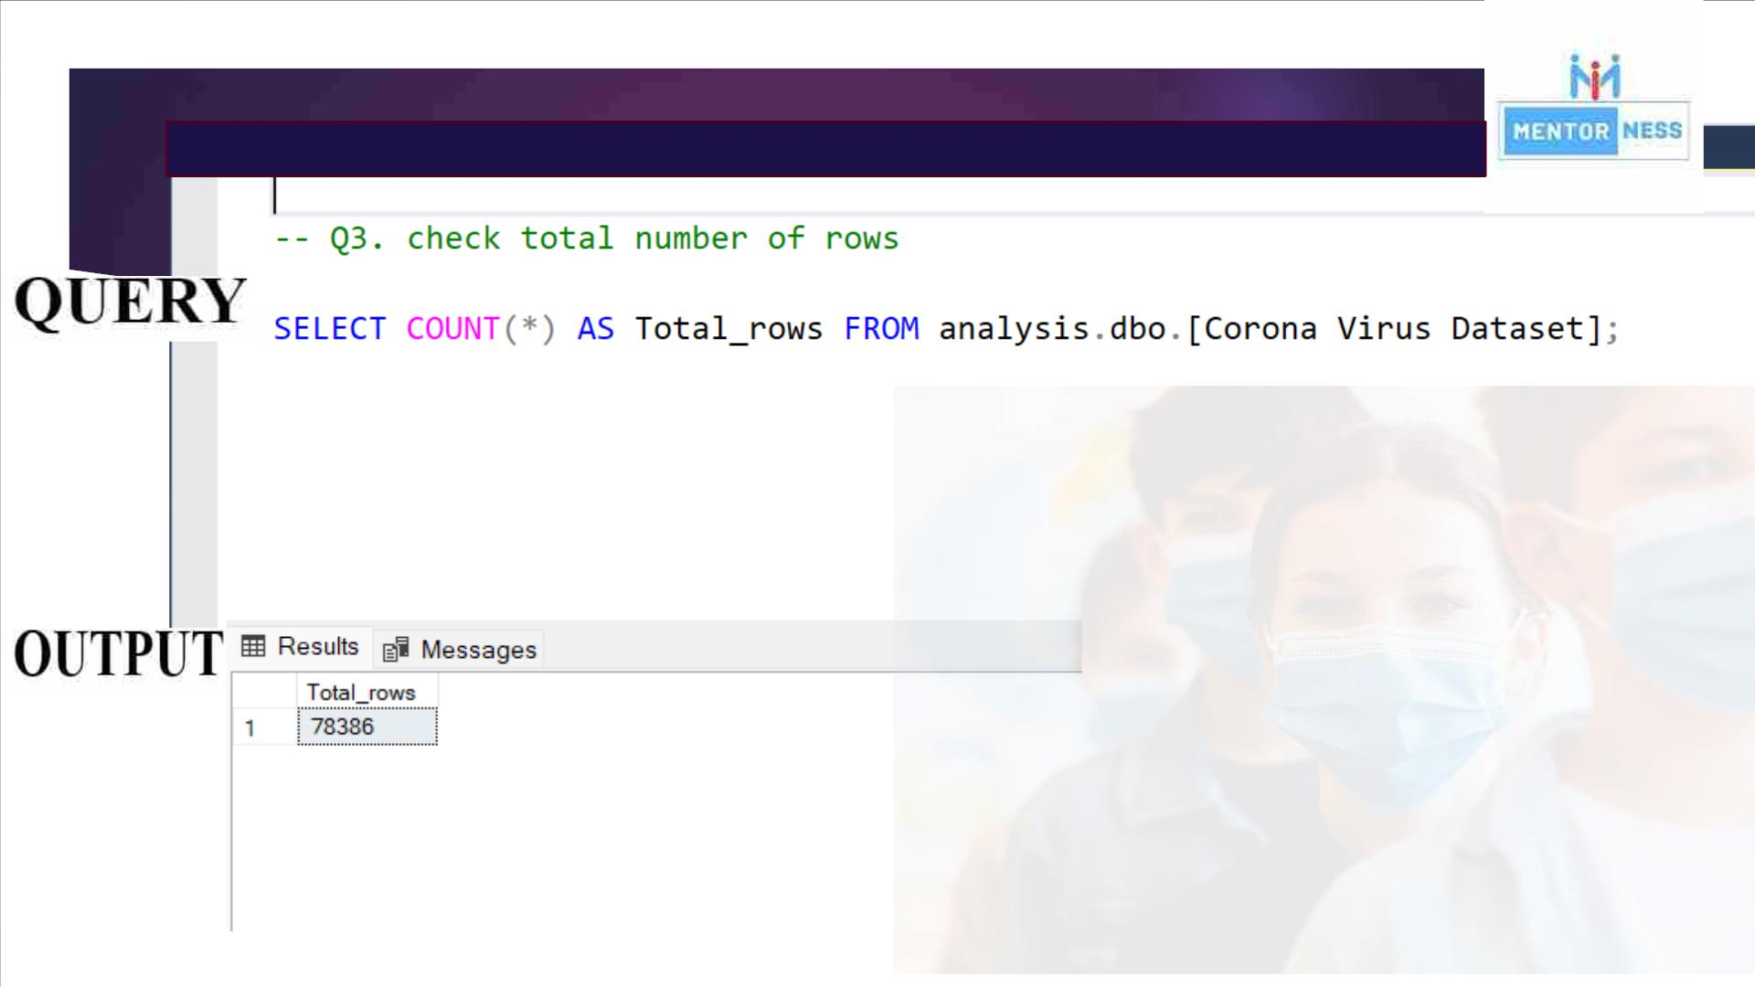

Slide 7
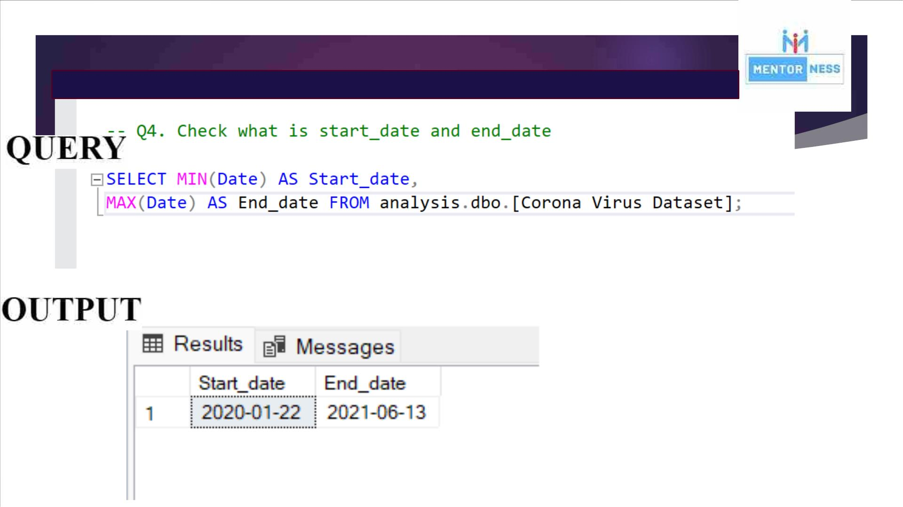

Slide 8
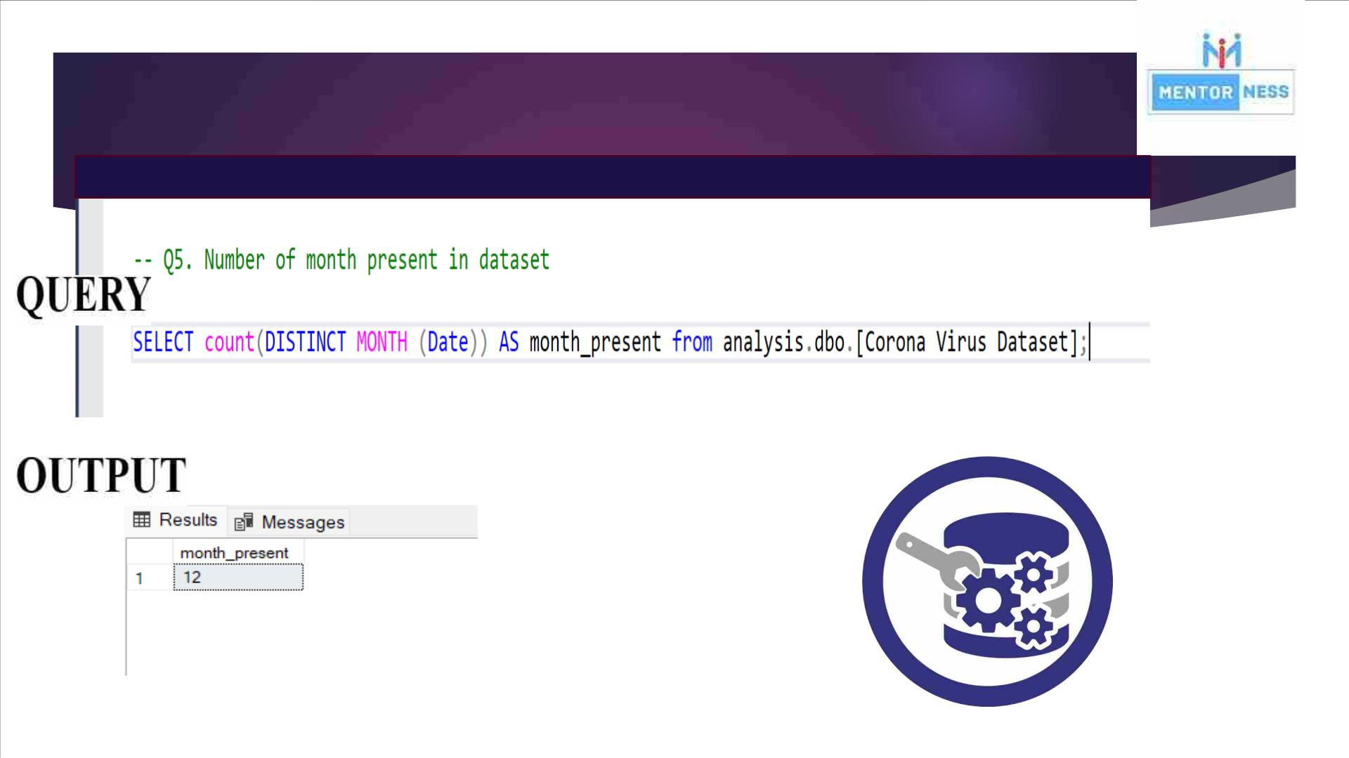

Slide 9
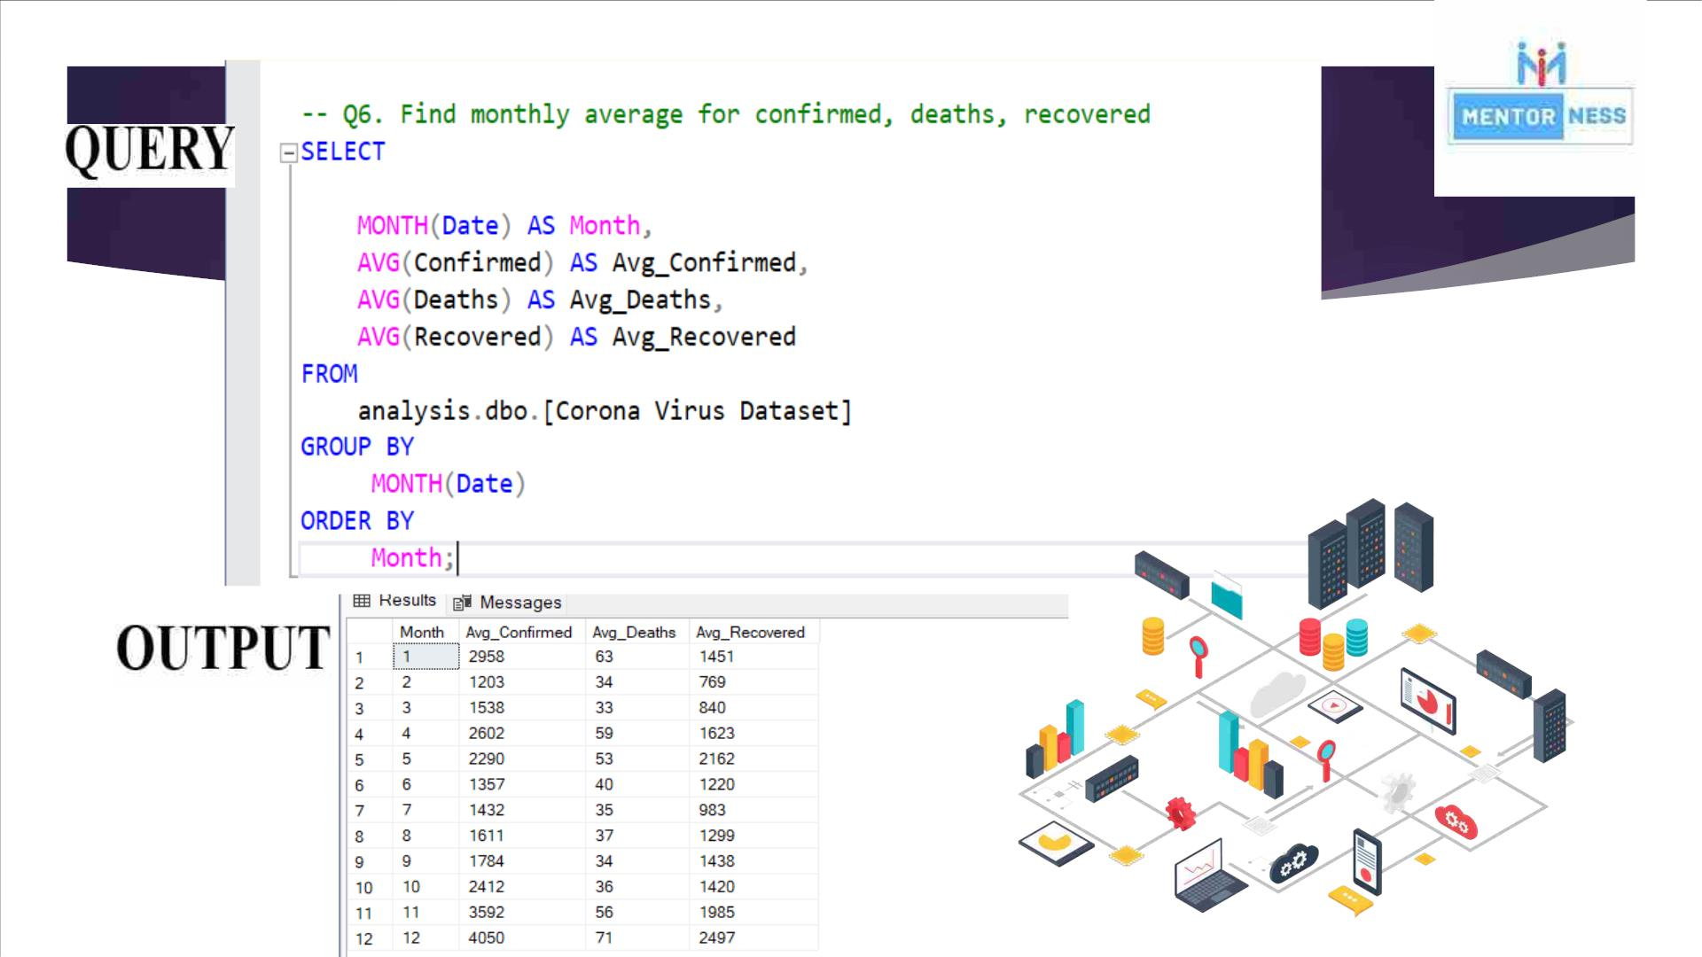

Slide 10
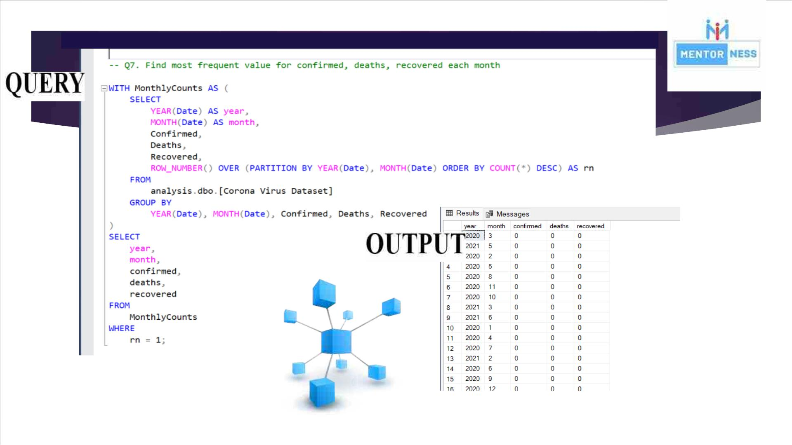

Slide 11
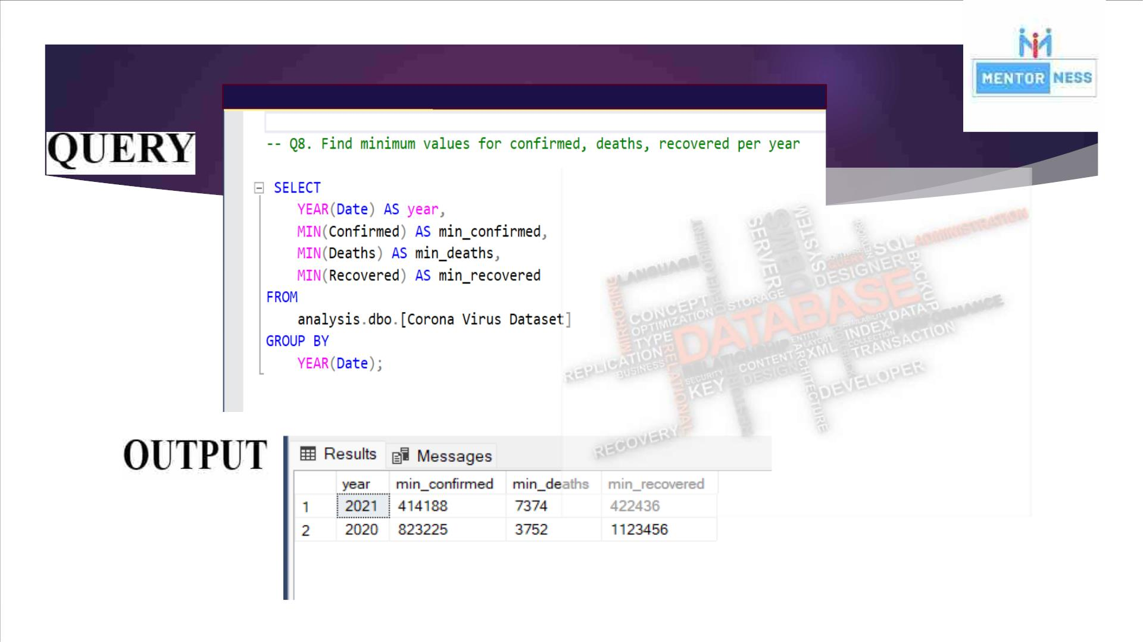

Slide 12
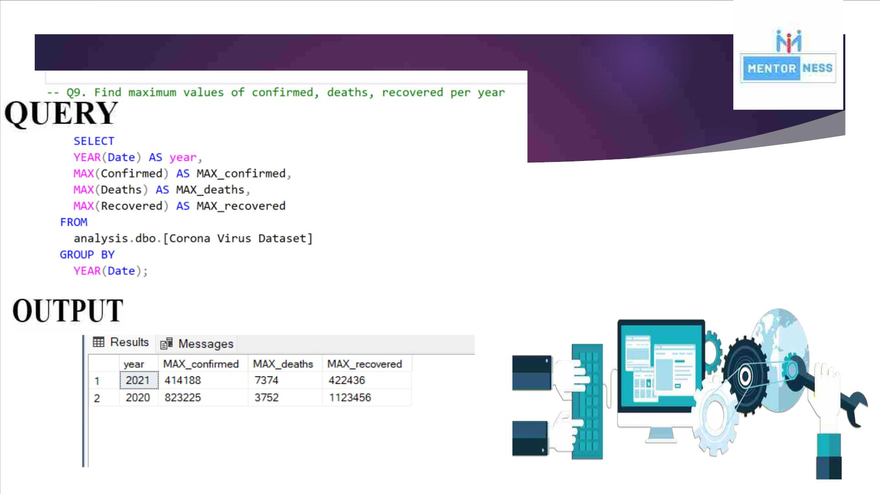

Slide 13
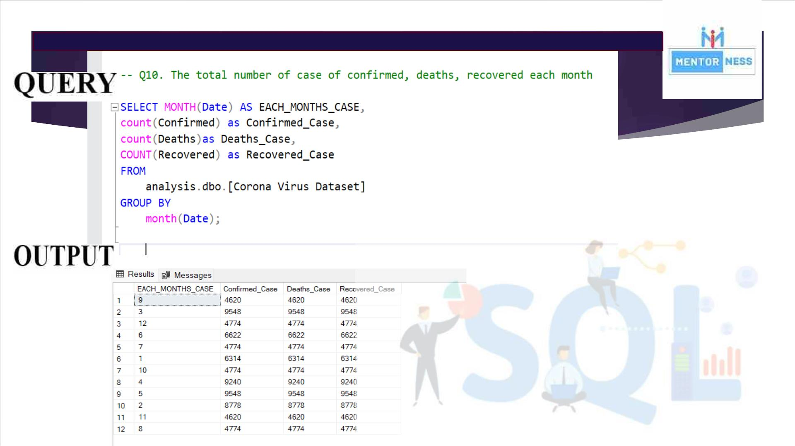

Slide 14
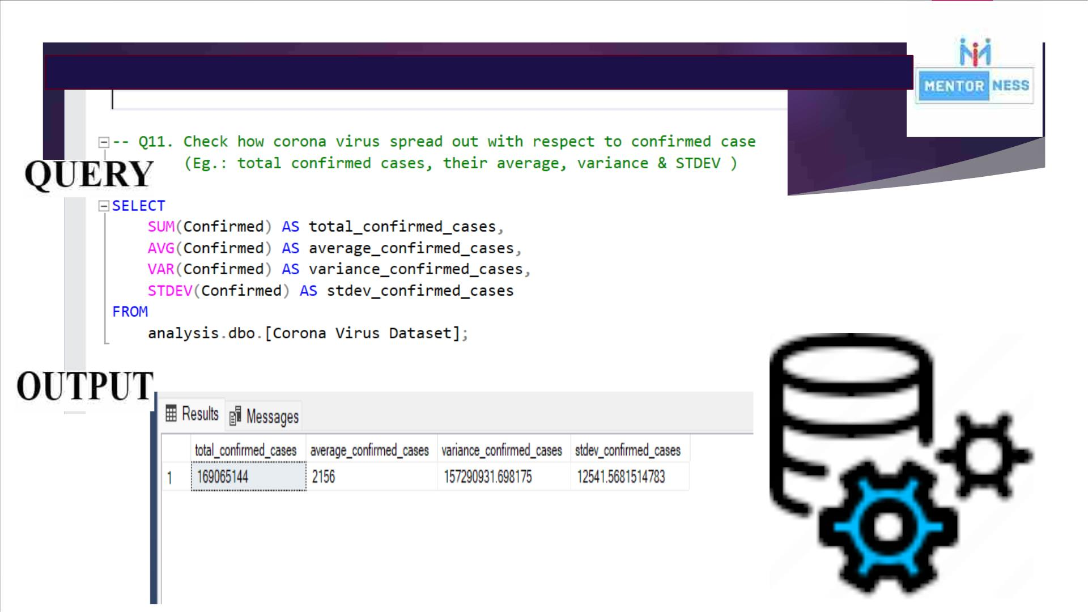

Slide 15
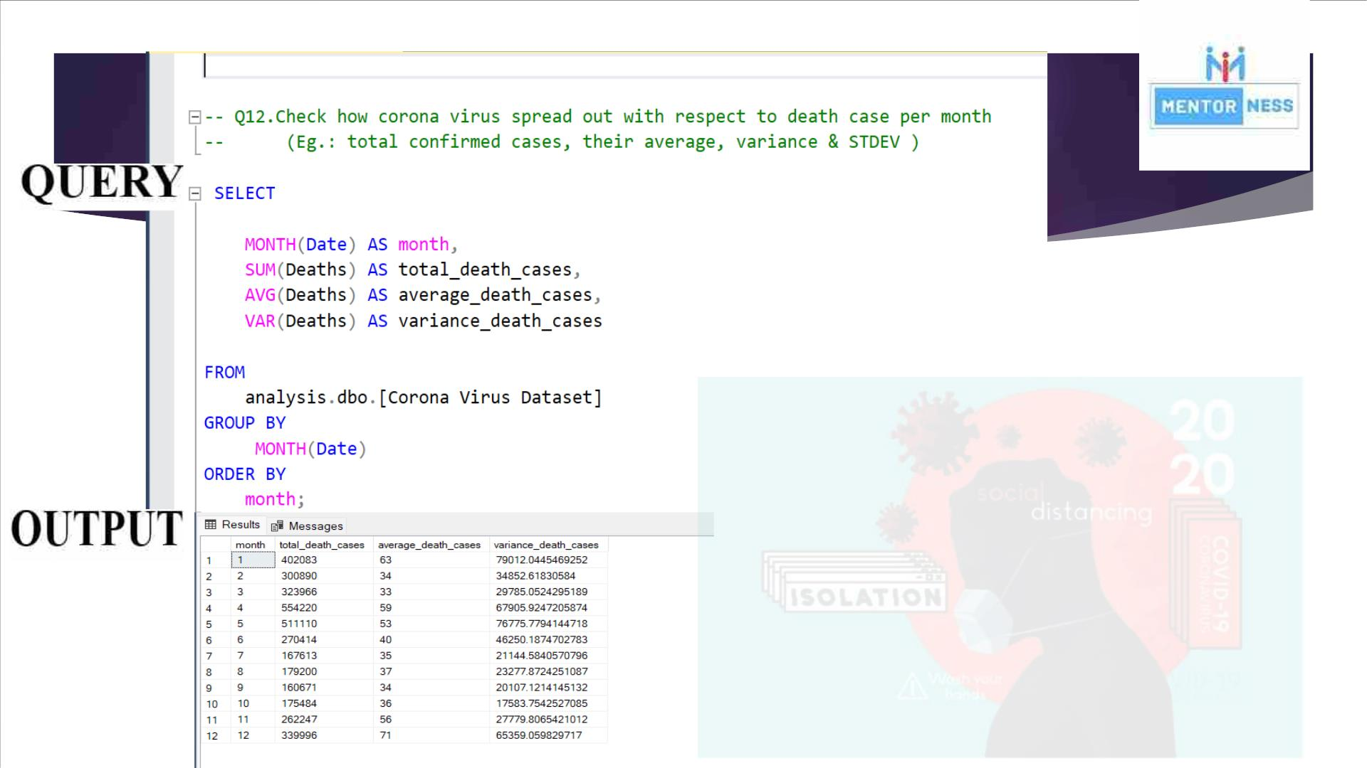

Slide 16
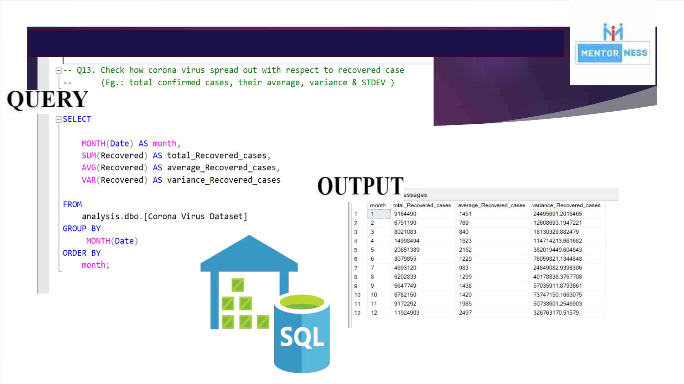

Slide 17
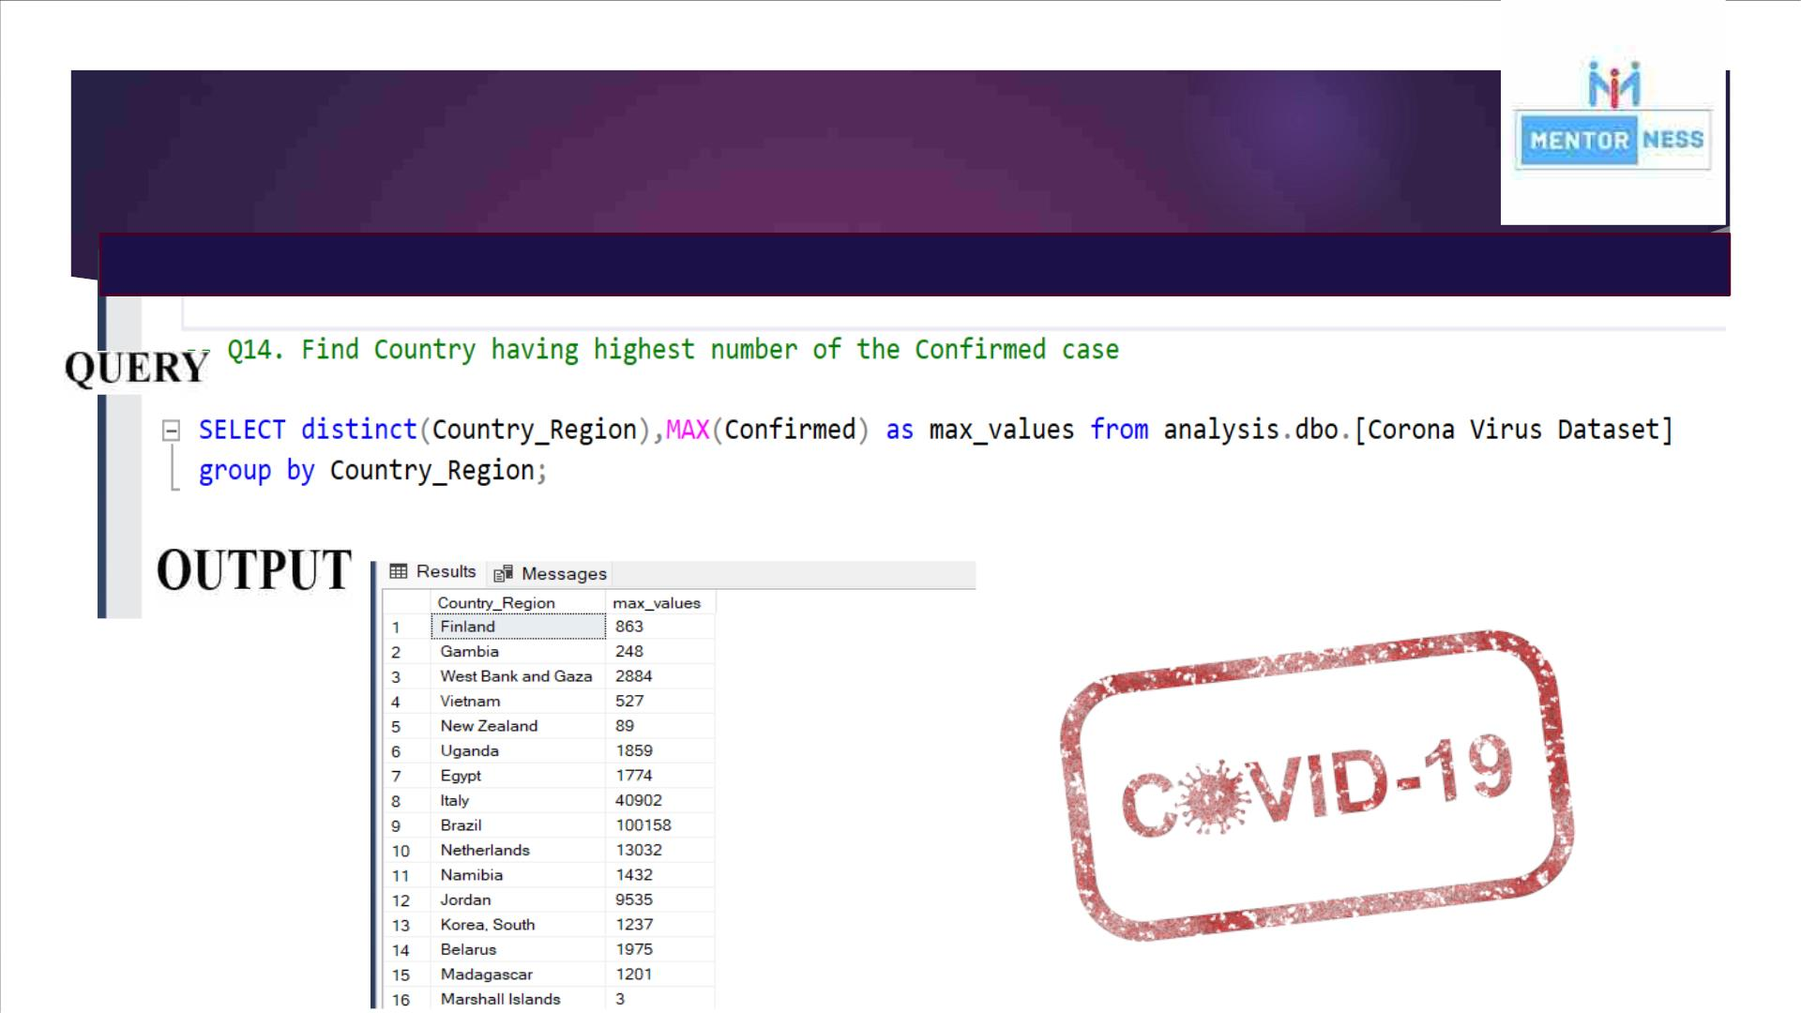

Slide 18
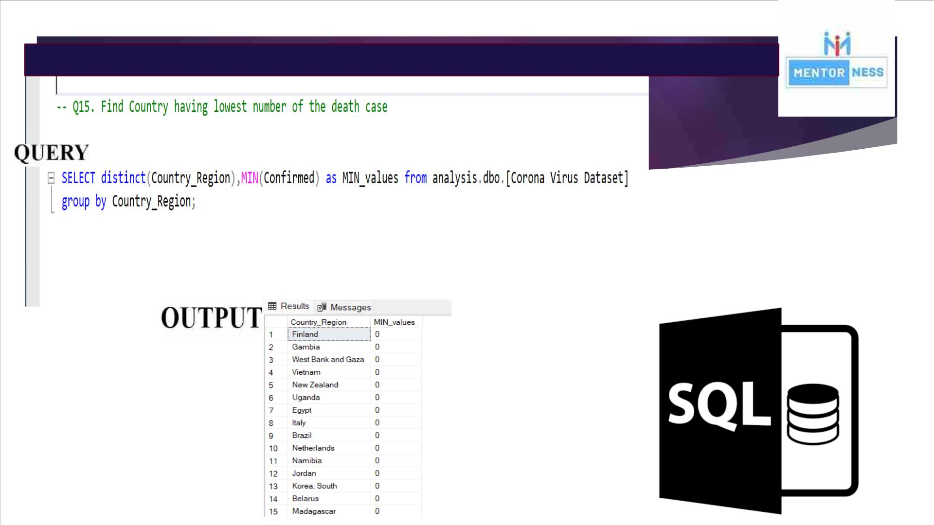

Slide 19
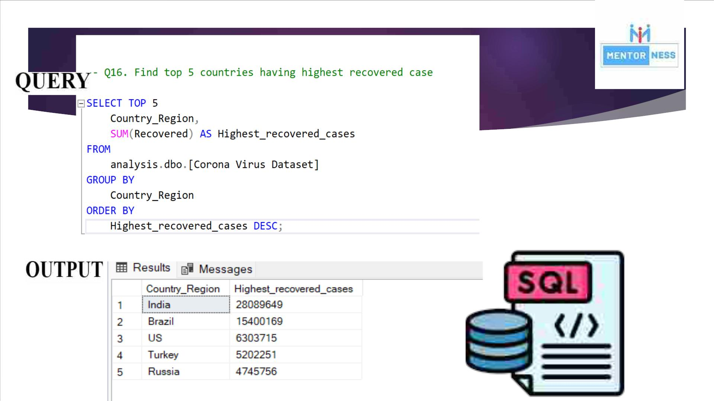

Slide 20

Conclusion :
◆ In the year 2021, there were total minimum - 414188 confirmed cases, 7374
deaths, and 422436 recovers.
◆ In the year 2020, there were total minimum of 823225 confirmed cases,
3752 deaths, 1123456 recovers.
◆ The highest recovery rate was of India with total of 28089649 recoveries.

Slide 21


